Slide 1
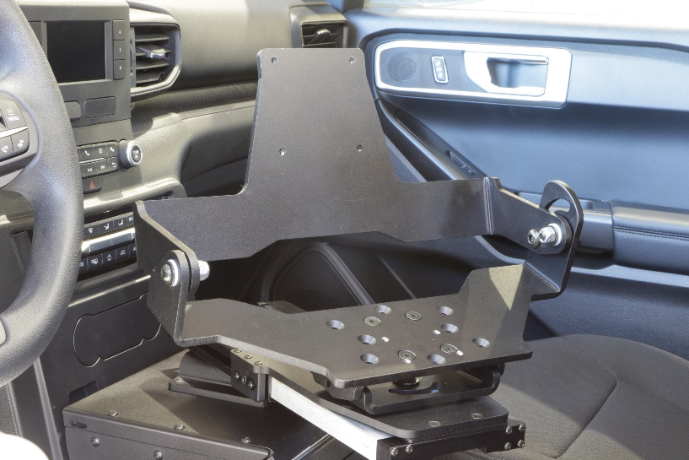
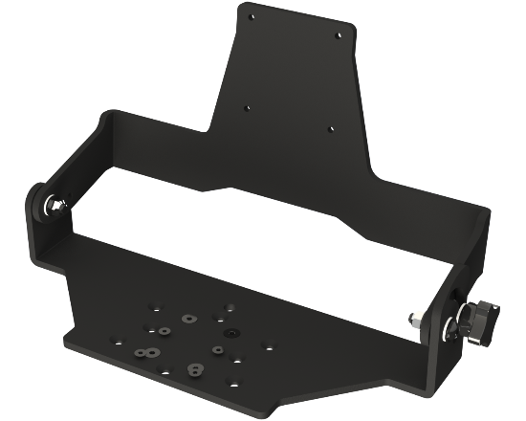
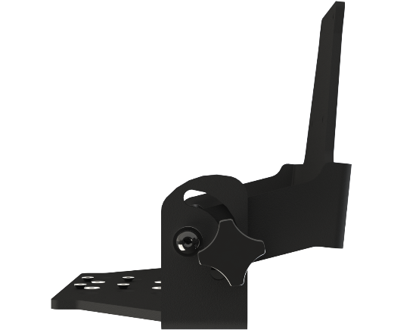
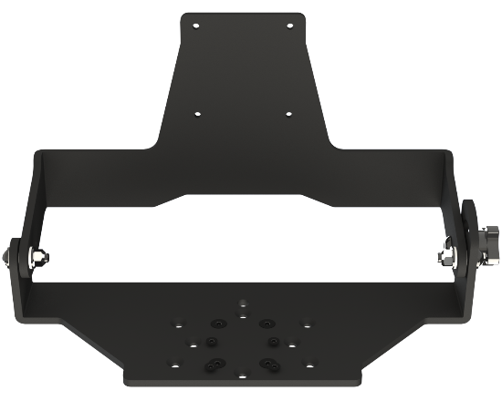
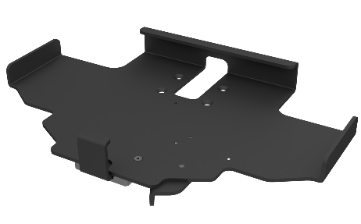
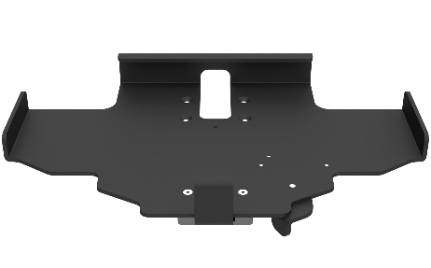
DOCK AND KEYBOARD MOUNTS
A range of products for mounting rugged keyboards with PMT docking stations to provide a clamshell style solution offering a the convenience of a laptop type set up. Manufactured from aircraft-grade aluminum and finished in high durability black epoxy powder coat for a long-lasting, rugged appearance.
Features
Aircraft grade aluminum construction
Modular to suit a variety of configurations to meet your specific requirements
Hinged design allows for angle towards driver; folds shut for easy and convenient access to dashboard controls
VESA 75 hole pattern allows for easy installation of a variety of docks and cradles
Slim, low profile and small size occupies less space

